Slide 1
Digital System Design
Chapter 2
Arithmetic Circuits

Slide 2
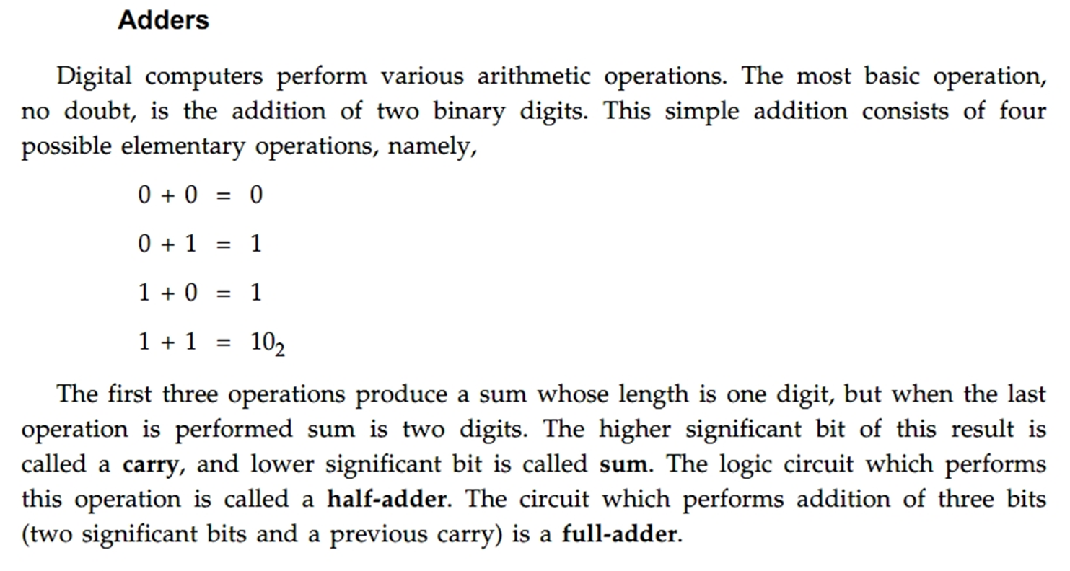
Addition of unsigned numbers

Slide 3
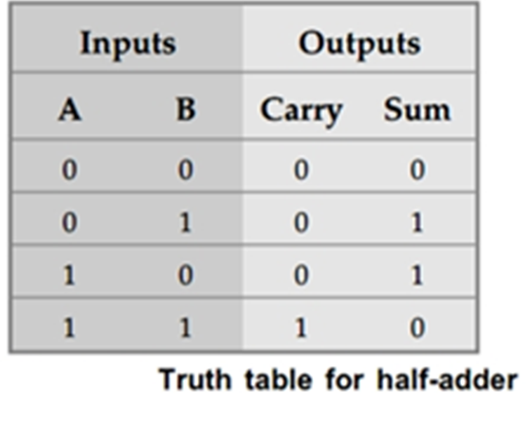
Half Adder
The half-adder operation needs two binary inputs augend and addend bits
And two binary outputs : sum and carry
A combinational circuit that performs the addition of two bits is called a half adder.

Slide 4
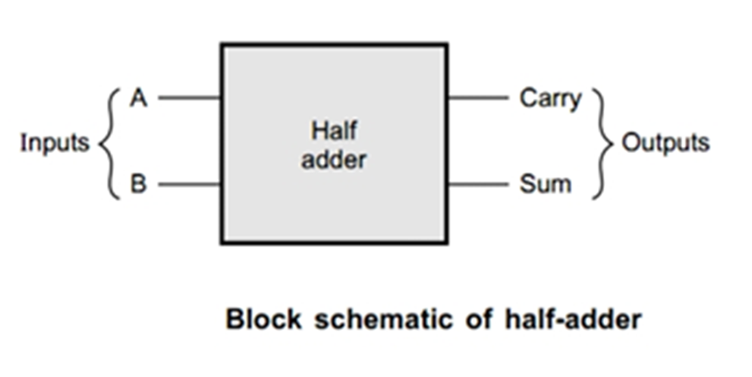

Slide 5
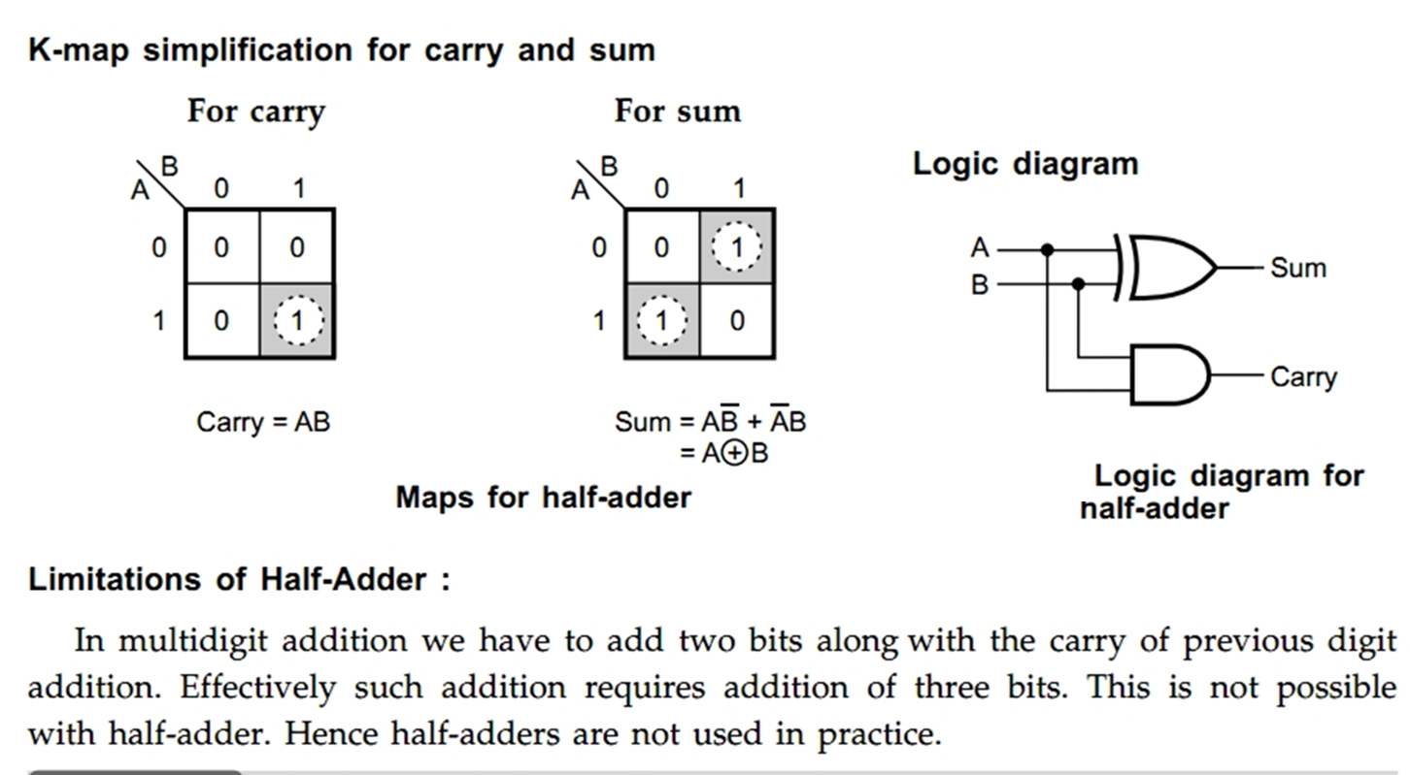
K-map simplification for carry and sum

Slide 6
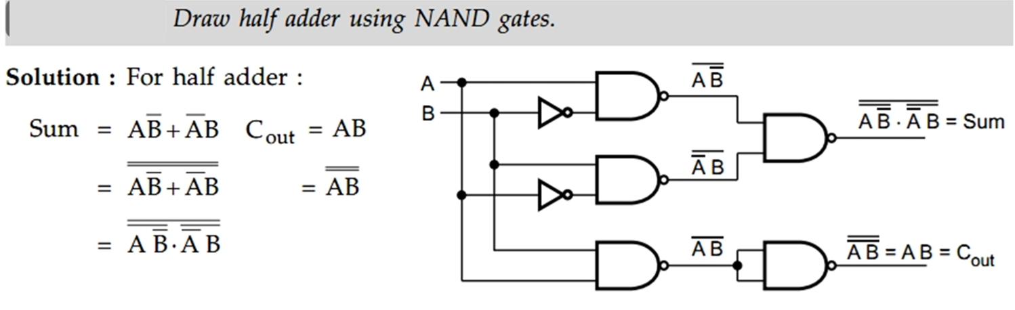
Half adder using NAND gates

Slide 7
Full Adder
A full adder circuit is a combinational circuit that can be used to add three bits to produce a SUM and a CARRY output.
Such a building block becomes a necessity when it comes to adding binary numbers with a large number of bits.
The full adder circuit overcomes the limitation of the half-adder, which can be used to add two bits only.
Procedure for adding larger binary numbers.
We begin with the addition of LSBs of the two numbers. We record the sum under the LSB column and take the carry, if any, forward to the next higher column bits. As a result, when we add the next adjacent higher column bits, we would be required to add three bits if there were a carry from the previous addition. We have a similar situation for the other higher column bits also until we reach the MSB.
A full adder is therefore essential for the hardware implementation of an adder circuit capable of adding larger binary numbers. A half-adder can be used for addition of LSBs only.

Slide 8
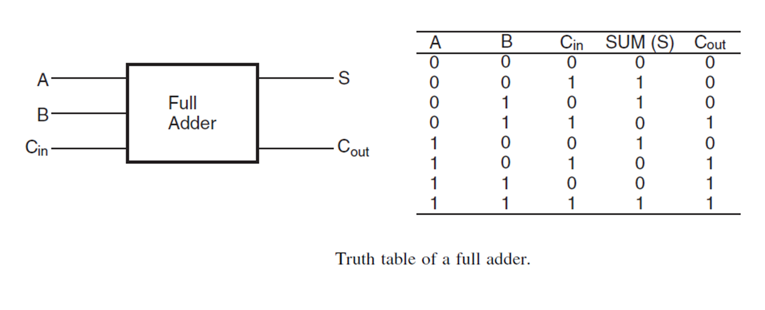

Slide 9
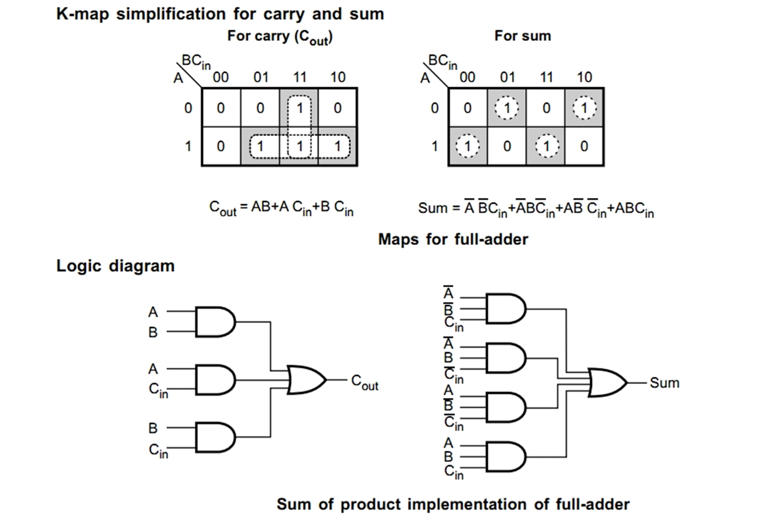

Slide 10
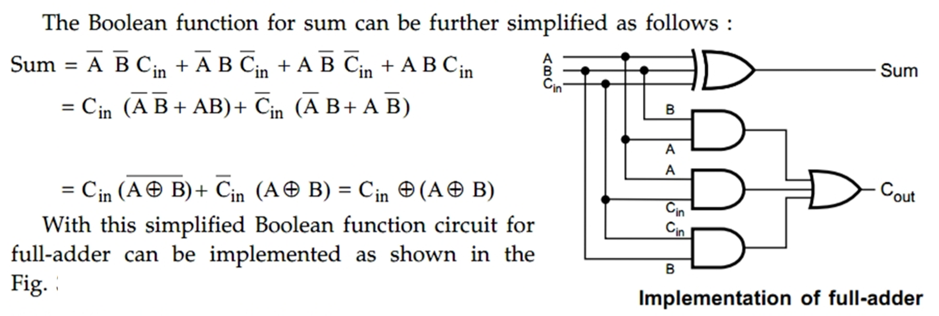

Slide 11
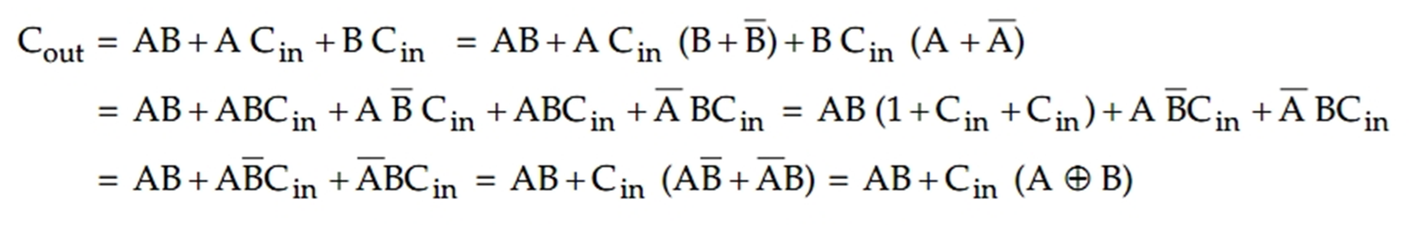

Slide 12
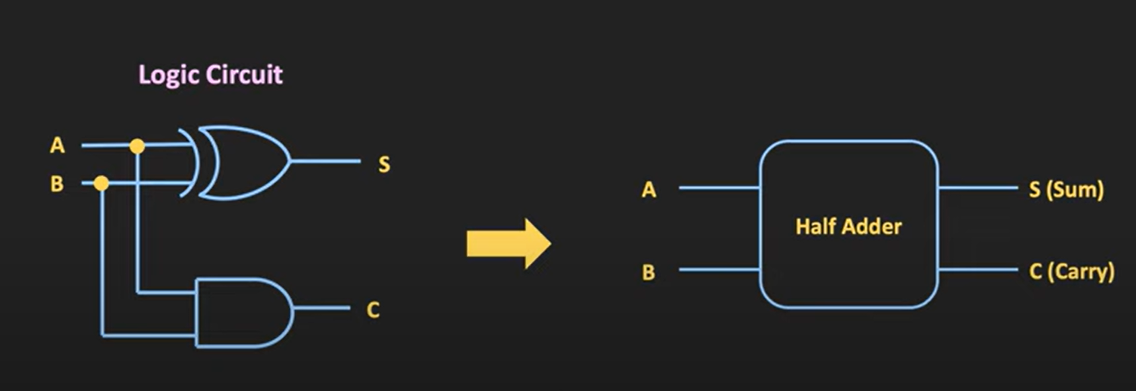

Slide 13
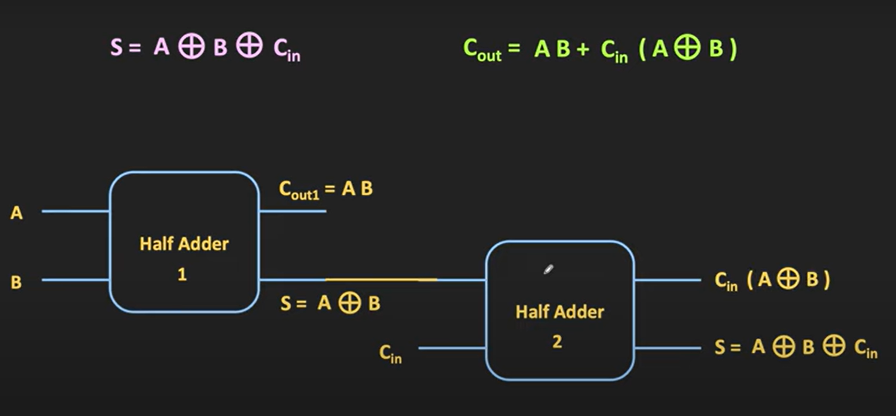

Slide 14
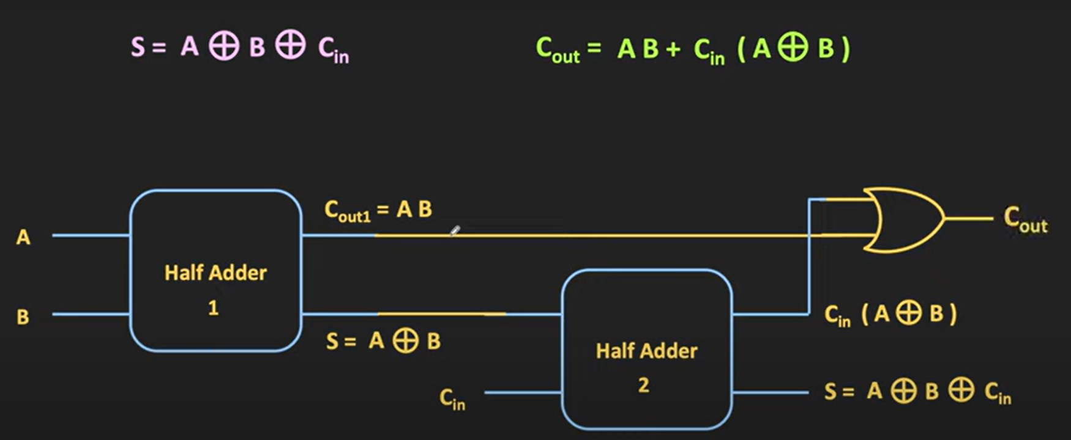

Slide 15
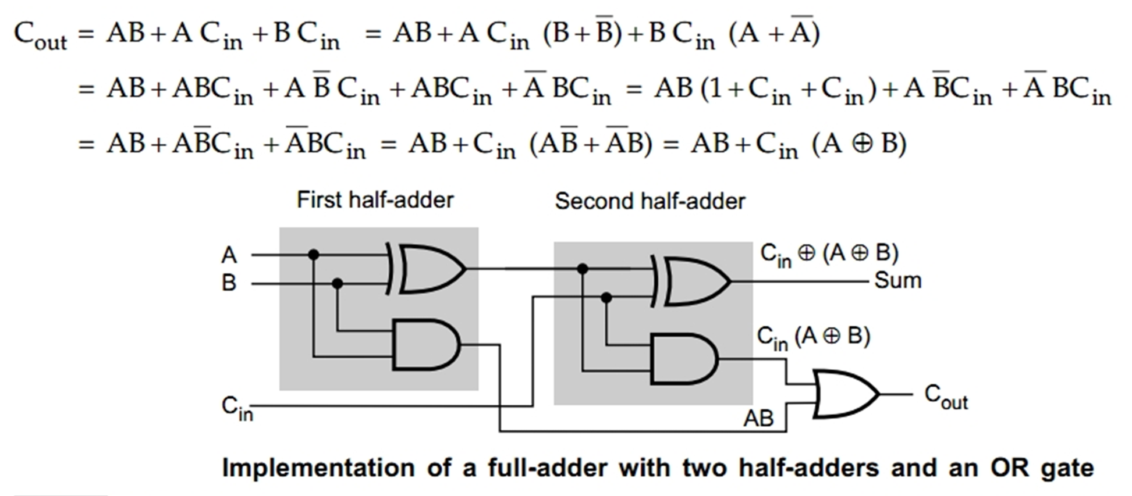
A full adder can also implement by using two half-adders and one OR gate. The sum output from the second half-adder is the exclusive-OR of C_{in} and the output of the first half-adder

Slide 16
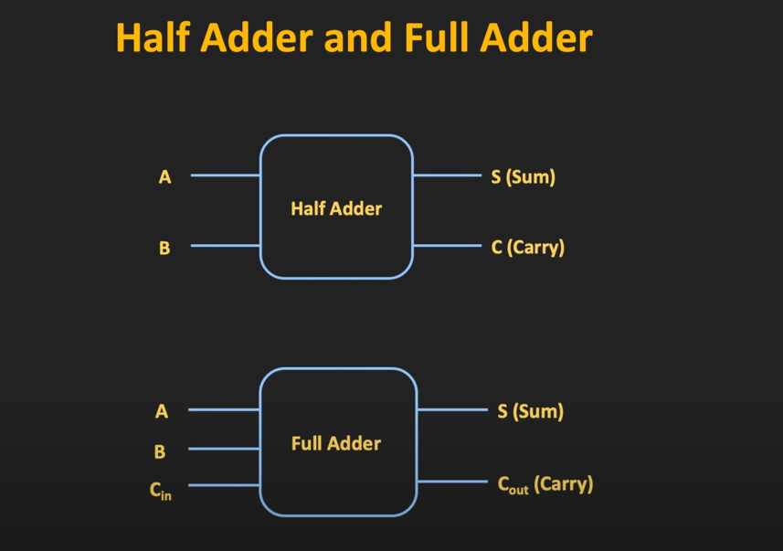
Ripple Carry Adder

Slide 17
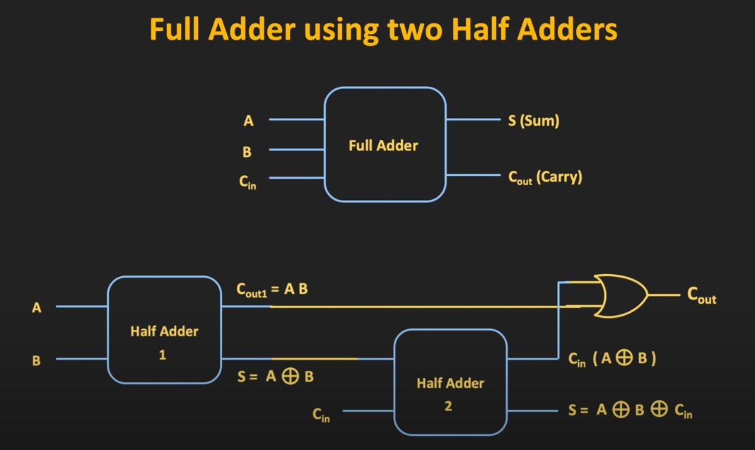

Slide 18
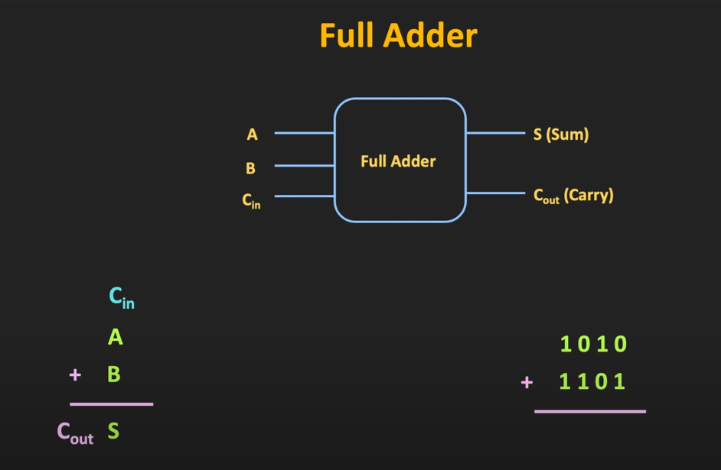

Slide 19
RIPPLE CARRY ADDER
A ripple carry adder is a digital circuit that produces the arithmetic sum of two binary numbers.
It can be constructed with full adders connected in cascaded, with the carry output from each full adder connected to the carry input of the next full adder in the chain.
Figure shows the interconnection of four, full adder (FA) circuits to provide a 4-bit ripple carry adder.
Because of the way the carry signals “ripple” through the full-adder stages, the circuit in Fig. is called a ripple-carry adder.
Ripple carry adder delays
In the ripple carry adder, the output is known after the carry generated by the previous stage is produced.
Thus, the sum of the most significant bit is only available after the carry signal has rippled through the adder from the least significant stage to the most significant stage.
As a result, the final sum and carry bits will be valid after a considerable delay.

Slide 20
Because of the way the carry signals “ripple” through the full-adder stages, the circuit in Figure 3.5 is called a ripple-carry adder.
The delay incurred to produce the final sum and carry-out in a ripple-carry adder depends on the size of the numbers.
When 32- or 64-bit numbers are used, this delay may become unacceptably high.
Because the circuit in each full-adder leaves little room for a drastic reduction in the delay, it may be necessary to seek different structures for implementation of n-bit adders.

Slide 21
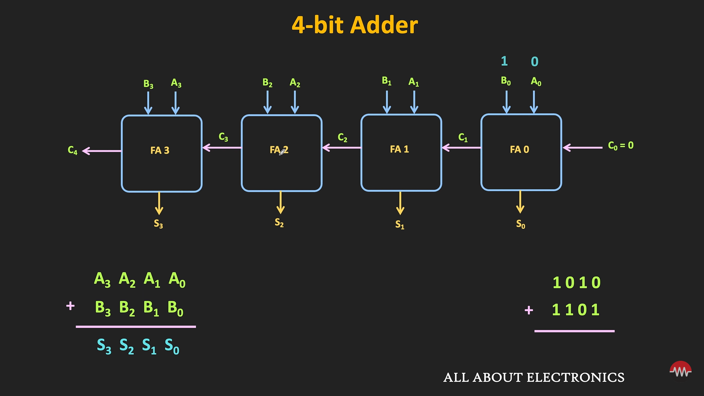
Ripple Carry Adder

Slide 23
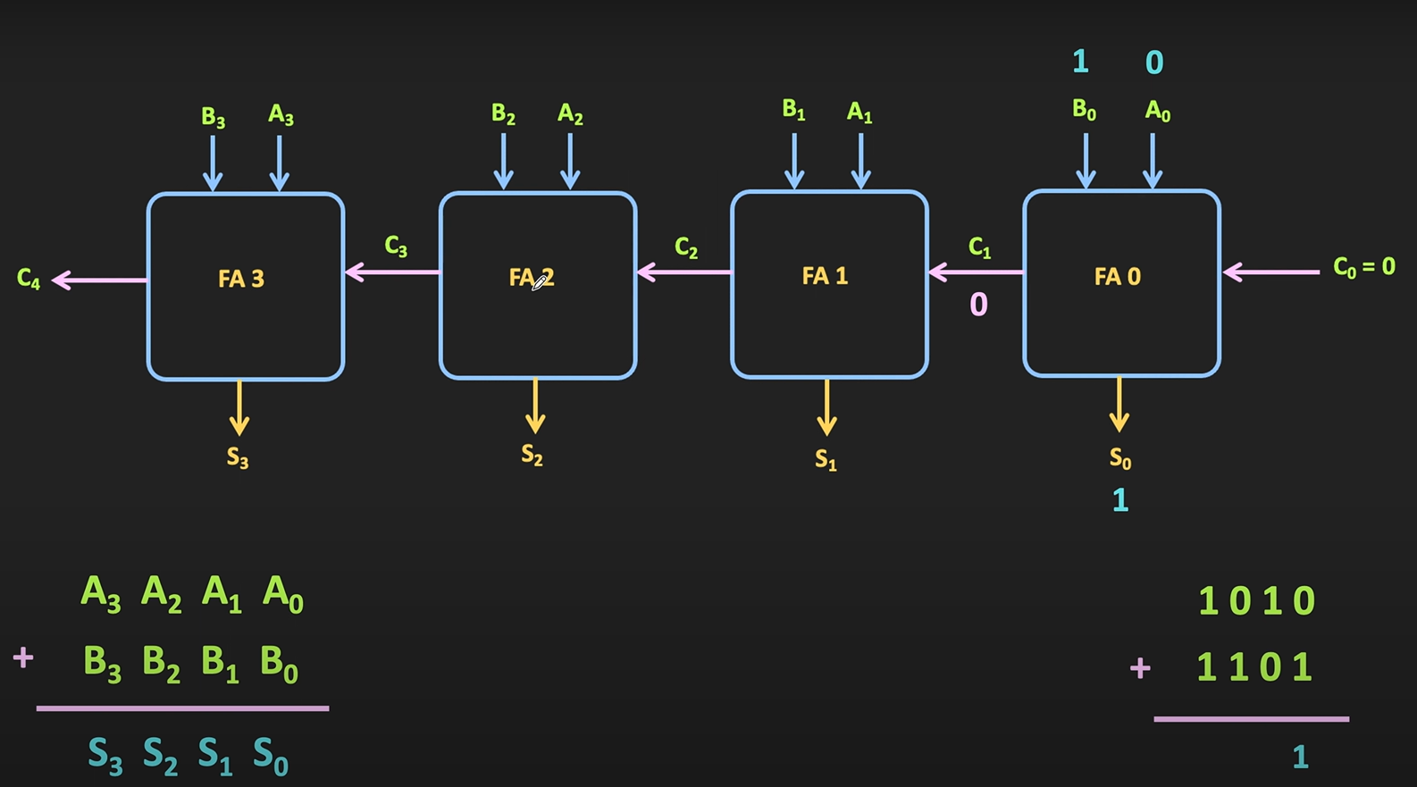

Slide 24
There are four, full adders, and A and B are 4-bit numbers
The FA₀ adds LSBs A₀ and B₀ and generates sum bit S₀ and carry bit C₀
While adding LSB as there is no previous carry, C₀ is set to zero.
The carry generated C₁ is given to the next full adder FA_{1.}
The FA₁ adds the two bits A₁ and B₁ along with the carry which is generated from the previous adder.
In the output sum bit S₁ and carry bit C₂ is generated
Like this way it proceeds further.

Slide 25
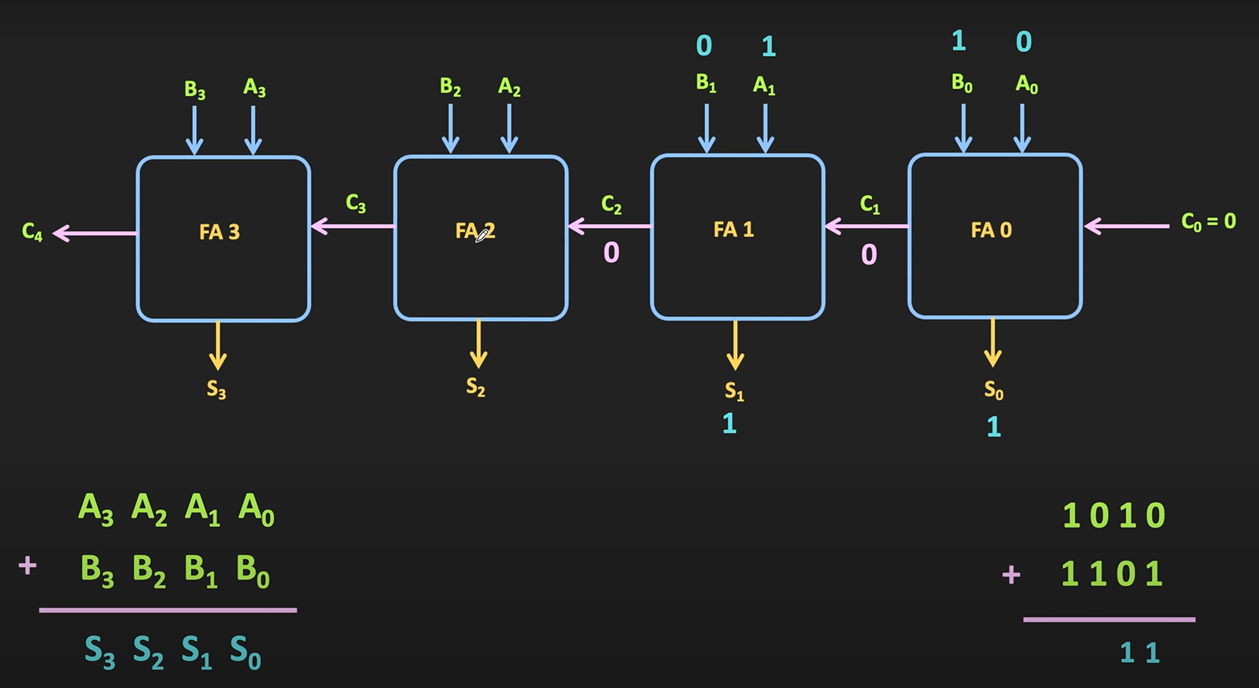

Slide 26
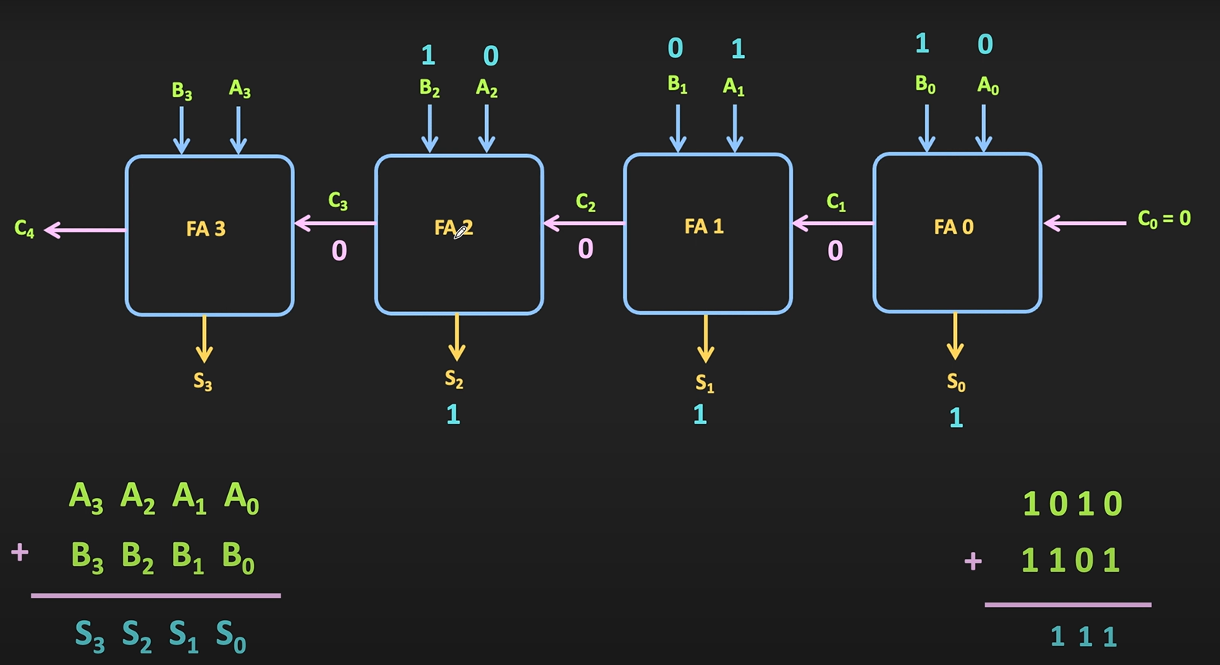

Slide 27
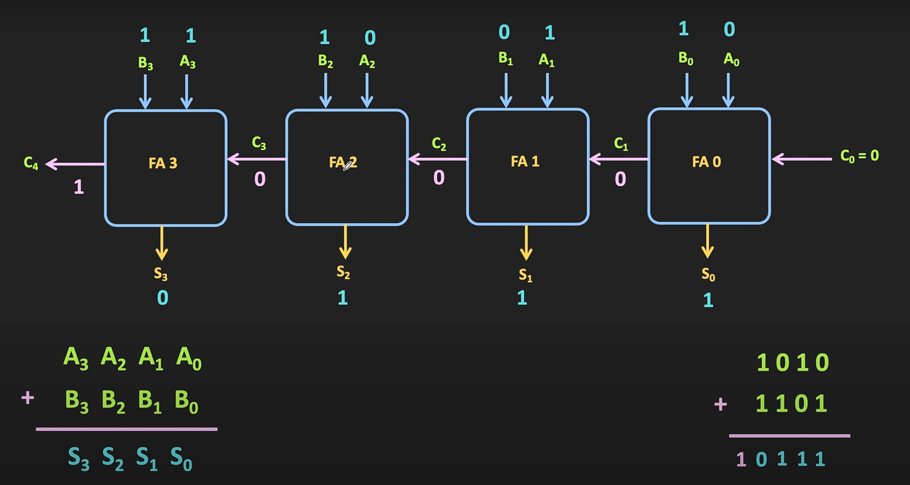

Slide 28
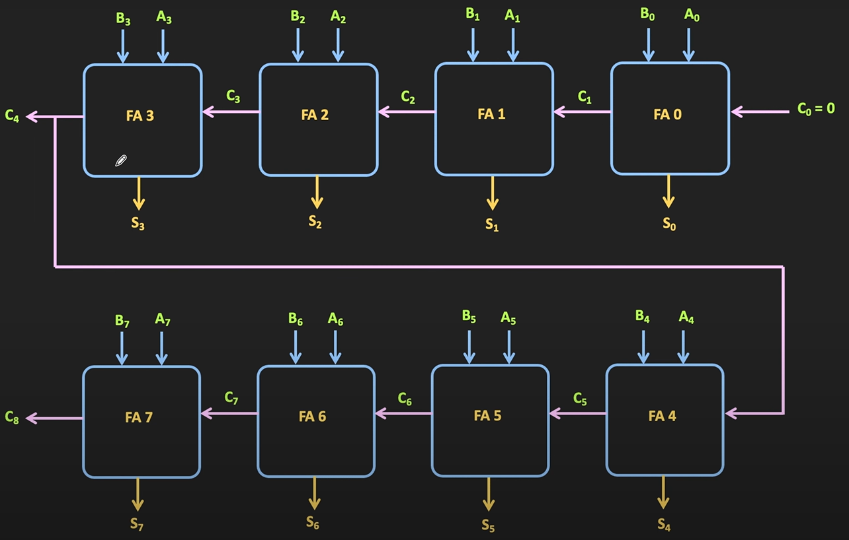
8-bit adder

Slide 29
Full adder
4-bit adder

Slide 30
